Slide 1
Ad-din Sakina Women’s Medical College Hospital
(Department of Gynae and ObsT)

Slide 2
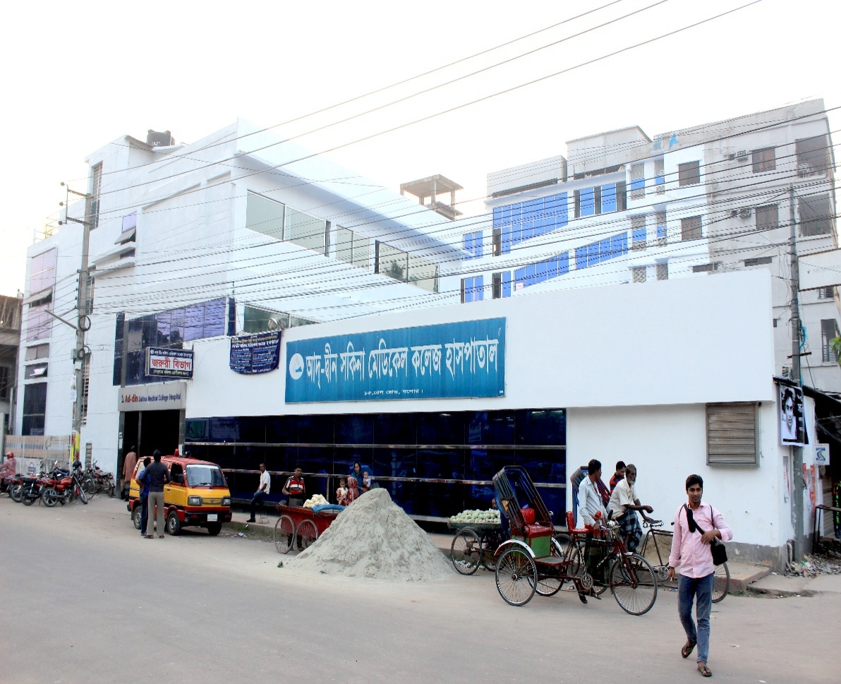

Ad-din Sakina Medical College Hospital
Start: 5 April 1985
Aims: To provide standard health service specially to the women, children And others at minimum cost .

Slide 3
Organogram
Head of the Department (1)
Professor (3)
Associate professor (1)
Associate professor CC (1)
Assistant Professor (0)
Residential Surgeon (1)
Registrar (1)
Assistant Registrar (1)
Medical Officer (2)

Slide 4
Nurses and Other Staffs
Matron (1)
Nursing Supervisor (4)
Senior Staff Nurse (41)
Others (22)

Slide 5
Activities
Teaching Service
Outdoor service
Indoor Service
Outreach Service

Slide 6
Academic activities
Under graduate level
Intern’s Doctor’s Training : morning session, case presentation, monthly mitting , discursion on referred case, Teaching according to log book.
5th year MBBS Class
4th year MBBS Class
3rd year MBBS Class
Nursing Training
Research study :
  wound infection
  Prom
  iud

Slide 7
Outdoor service
Reception and Registration
ANC Checkup by mid wife NURSEs
Checkup- by Professor or Medical officer OR NURSEs
PNC And FP services
Health education services
Pathology service
Radiology and imaging
Pharmacy service
utsho store and mayer choa cafeteria
Ambulance services

Slide 8
Indoor Service
safe labour unit
Labour and gynae ot
Post operative unit
Gynae ward: Admission, observation, pre operative checkup
Lab activities :
1. all required investigation
2. USG
3. Paps tesr
4. hysterosalpingogram
Operations
caesarian section
total abdominal hysterectomy
vaginal hysterectomy
De&c
All Ovarian operations

Slide 9
Outreach Service
OPD at field level
Anc , pnc and referral service
Fistula diagnosis and referral case
Ambulance service
Rehabilitees services

Slide 10
Performance of gynae and obst Department from 2010-2021(Jan-Nov)
Year | Total IPD Patients | Total OPD Patients | Gynae Patients | ANC | PNC | FP | C/S | Delivery | Total Delivery | DE&C | Gynae OT
2010 | 5408? | 55710 | 7802 | 28161 | 6765 | 3516 | 2715 | 577 | 3292 | 91 | 21
2015 | 7807? | 84682 | 8105 | 25249 | 6460 | 3860 | 2879 | 606 | 3485 | 198 | 40
2018 | 10182? | 95187 | 9779 | 25325 | 5992 | 3376 | 3446 | 616 | 4062 | 446 | 88
2019 | 10783? | 98637 | 9362 | 24117 | 6217 | 3412 | 3336 | 826 | 4162 | 326 | 67
2020 | 8565? | 75003 | 6749 | 21673 | 5697 | 3315 | 3213 | 654 | 3867 | 298 | 64
2021 (Jan-Nov) | 7636? | 64332 | 7180 | 15641 | 5534 | 391 | 2621 | 430 | 3051 | 329 | 65

Slide 11
Types of obst patients admitted in obs ward
Title | Number
Pregnancy with Previous C/S | 580?
Pregnancy with Lower abdominal pain | 581
Pregnancy with Less fetal movement | 454
Pregnancy with PROM | 330
Pregnancy with UTI | 424
Pregnancy with Ante partam haemorrhage | 157
Pregnancy with Anemia | 943
Post Dated Pregnancy | 58
PIH | 349
True labour pain | 632
Hyper Emesis graviderum | 208
Pregnancy with Oligohydramnios | 512
Pregnancy with PUO | 87
IUD | 14?
Pregnancy with Big baby | 58
Pregnancy with Breach | 34

Slide 12
Gynae operation list(Jan-Nov-2021)
Total abdominal hysterectomy | 30
Sub total abdominal hysterectomy | 2
Vaginal hysterectomy | 3
Laparotomy | 13
Ovarian cystectomy | 6
Perineal tear | 27
Biopsy | 2
Bartholin cyst | 2
Total = | 85

Slide 13
Family planning sector report
Title
OCP | 1960
Condom | 5300
DMPA | 288
Cupper - T | 1
Ligation | 53

